Slide 1
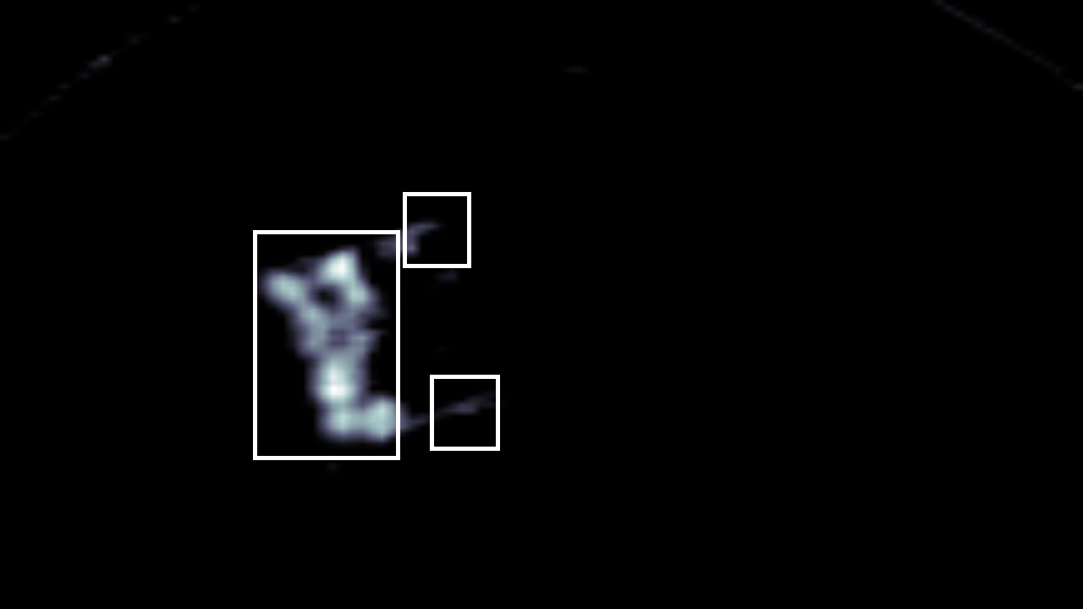
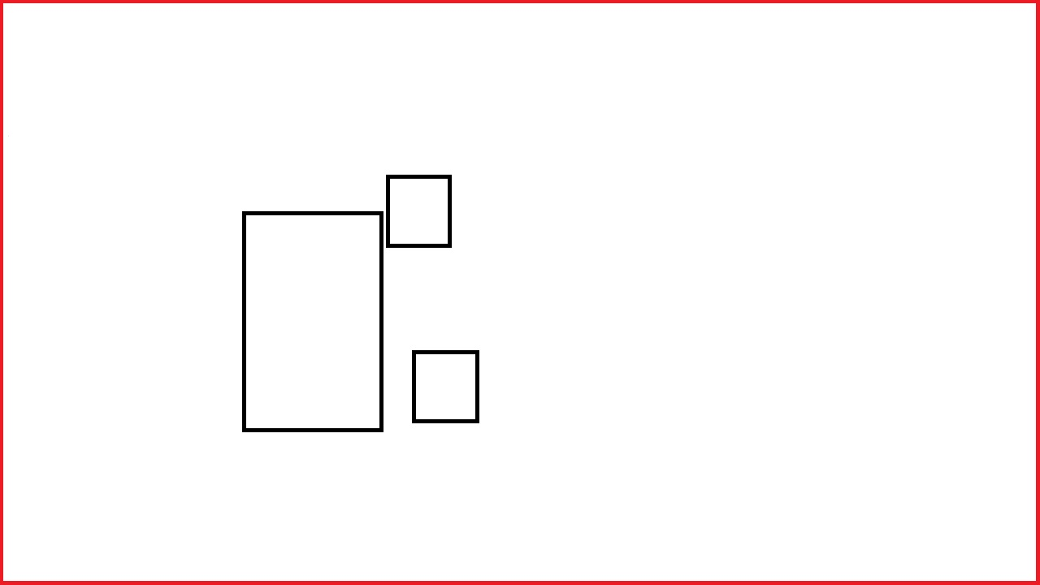

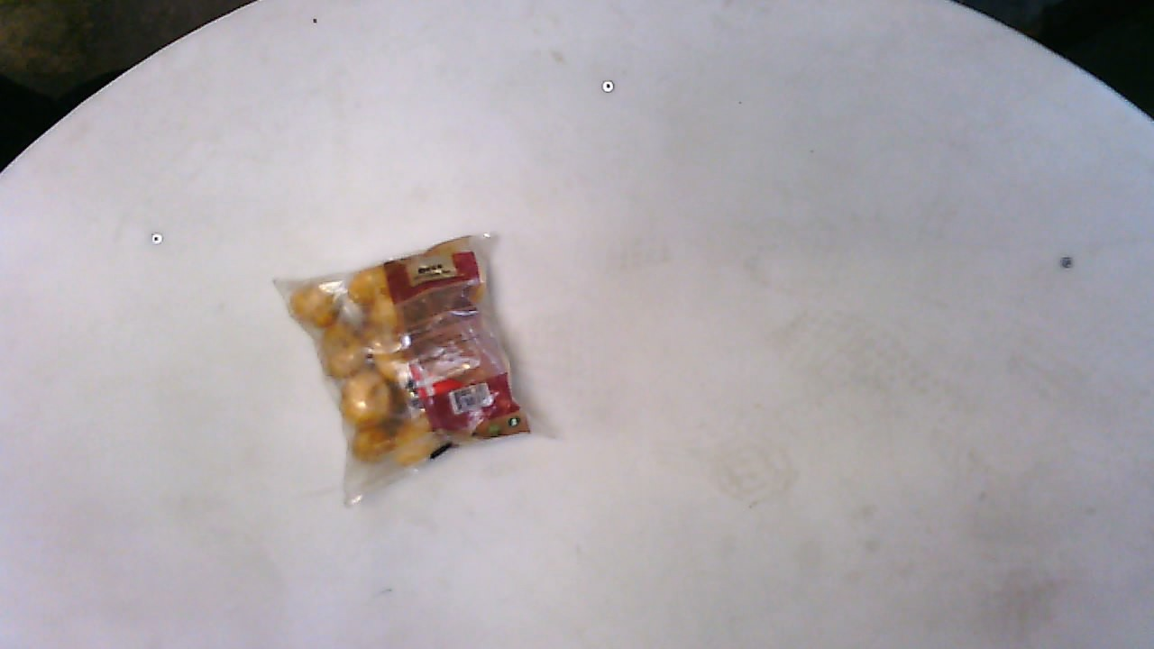
Bounding box regression loss
Classification loss
Classification network
Bounding box regression loss
Classification loss
RoI Pooling
Proposal regions
Region proposal network
Feature map
Conv

